Slide 1

Software Engineering Team Project

Slide 2

Team Lead: Andrew McKissick
Devin Ritter, Tellon Smith, Johann Redhead, Anderson Nwammadi

Slide 3
Overview
What is our project?
Team Organization
Diagrams
Development Tools

Slide 4
What is Our Project? Card Services: Wells Fargo
Customer
Dr. Terry Griffin, Assistant Professor at Midwestern State University
Goals
Redesign user interface
Enhance user productivity
Added security features

Slide 5
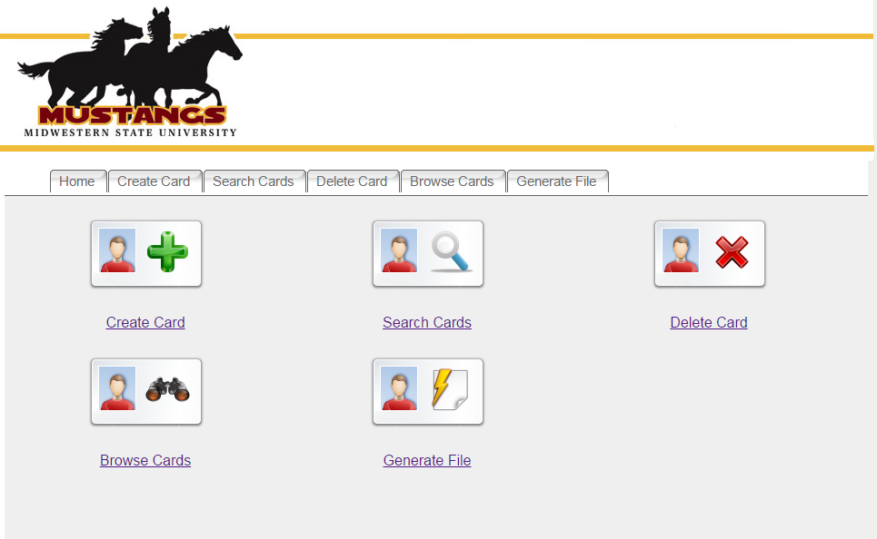
Old Homepage

Slide 6
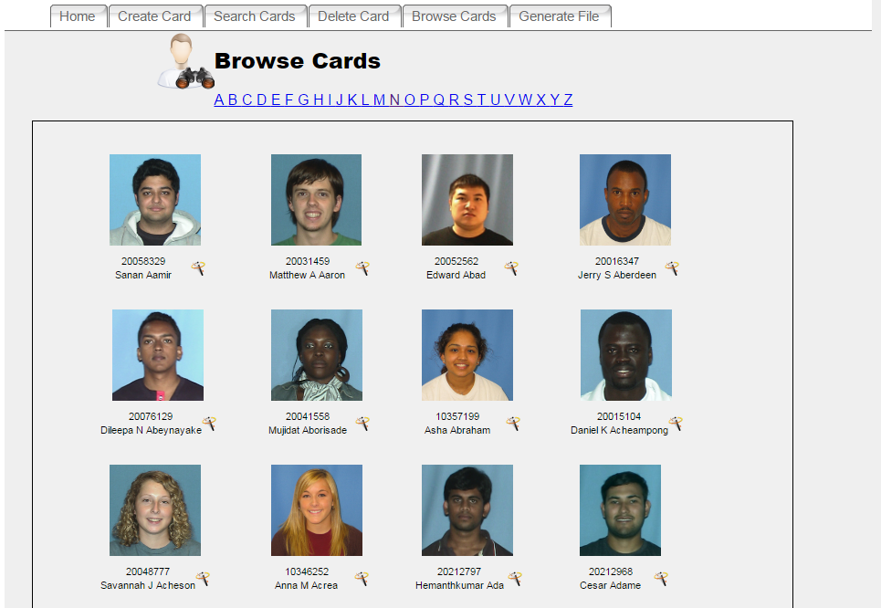
Old Browse Page

Slide 7
*User interface screenshots

Slide 8
*User interface screenshots

Slide 9
*User interface screenshots

Slide 10

Team Organization Communication

Slide 11
Team Organization Communication
What is Slack?
Cross-platform application
Individual or group chat
What did we use Slack for?
General communication
Suggestions on works
Coordination of assignments and deadlines

Slide 12


Team Organization File Management

Slide 13
Team Organization File Management
What is GitHub?
Git repository hosting service
Web-based graphical interface
Control and collaboration features
What did we use GitHub for?
Open storage for files
Upload and download individual works

Slide 14
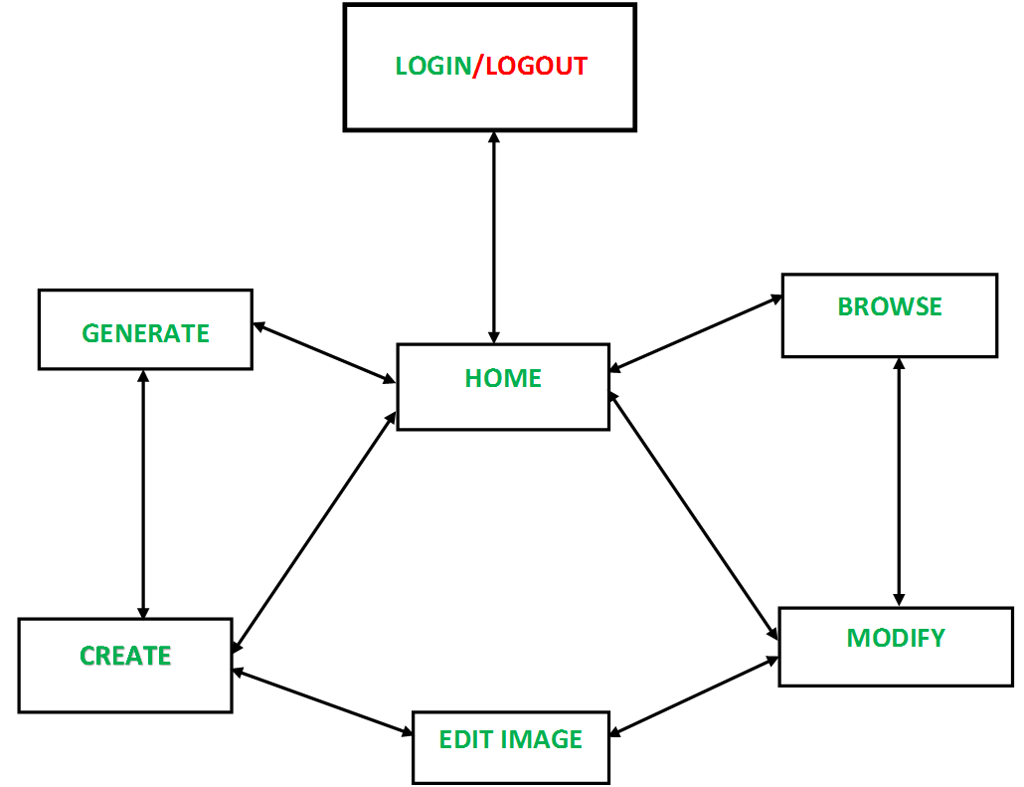
Diagrams Navigation

Slide 15
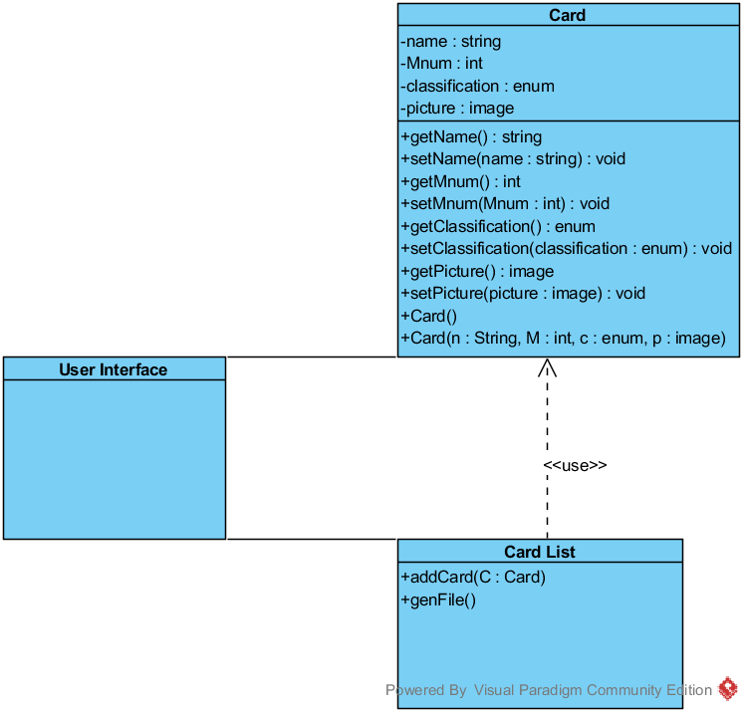
Diagrams Class

Slide 16
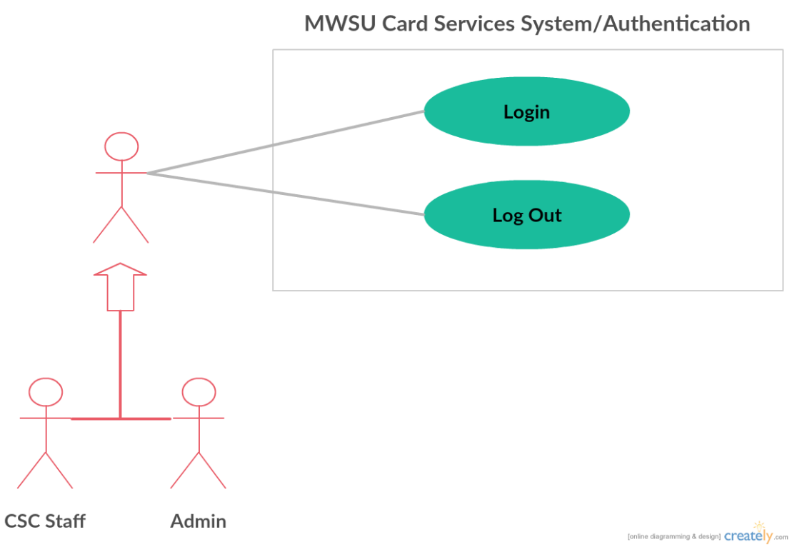
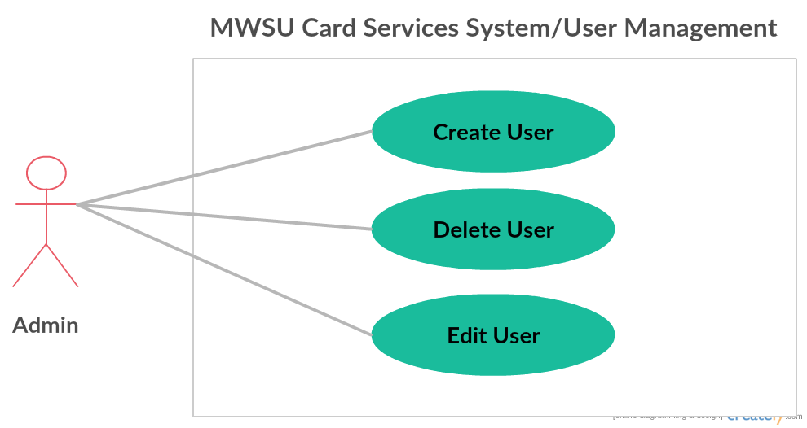
Diagrams Use Case

Slide 17
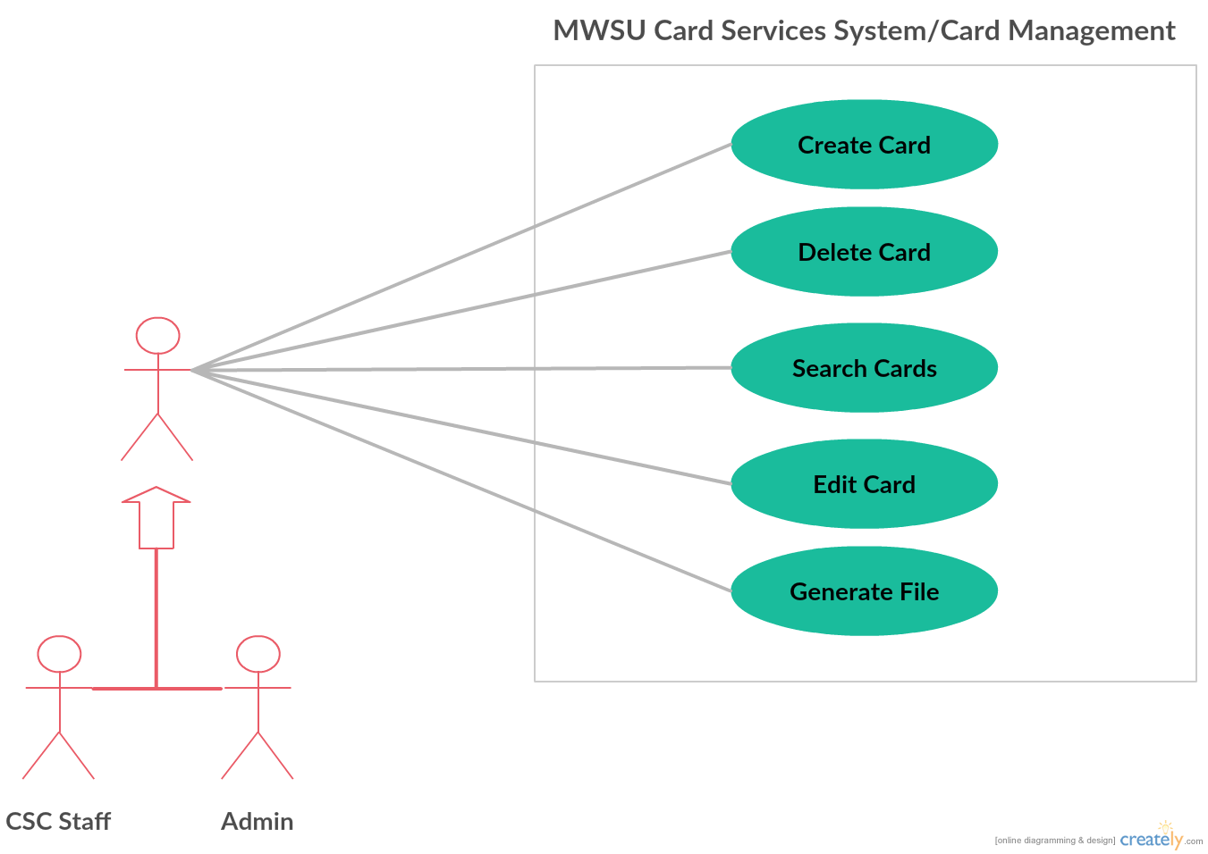
Diagrams Use Case

Slide 18
Development Tools Visual Paradigm
What is Visual Paradigm?
System modeling software
What we used it for
Create diagrams

Slide 19
Development Tools XAMPP
What is it XAMPP?
Local web hosting tool
*What we used it for
Create local server

Slide 20
Development Tools Notepad++
What is Notepad++?
A text editor
Extensive plugin library
What we used it for
Write & Edit code

Slide 21
Thank You! Questions?
References
Kung, David, Object-oriented Software Engineering: An Agile Unified Methodology. New York, NY: McGraw-Hill, 2013. Print.
XAMPP. (n.d.). Retrieved March 01, 2017, from https://www.apachefriends.org/index.html
Visual Paradigm. (n.d.). Retrieved March 01, 2017, from https://www.visual-paradigm.com/

